Slide 1

.
.

Slide 2
SUPER COMPUTER
Introduction to Supercomputers
Key Features of Supercomputers
How Supercomputers Work
Applications of Supercomputers
Famous Supercomputers
Challenges of Supercomputers
The Future of Supercomputers

Slide 3
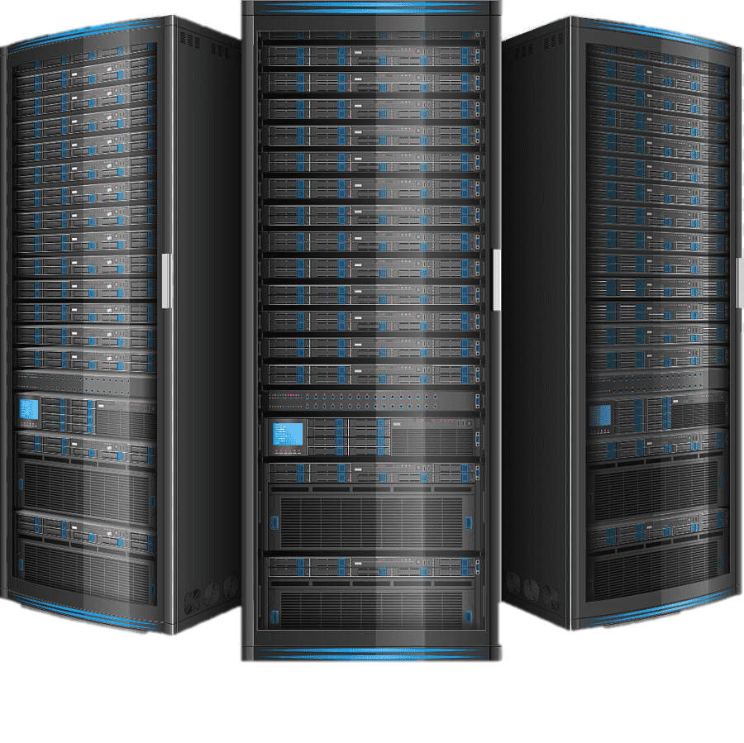
Introduction to Supercomputers
What is a Supercomputer:
A supercomputer is a high-performance computing machine designed to perform tasks that require massive computational power.
It has much more processing power than standard computers.

Slide 4
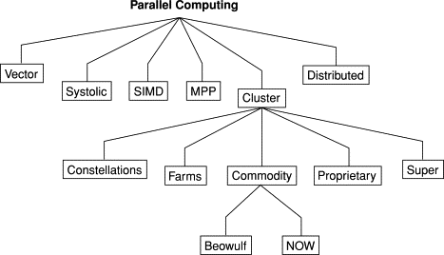
Key Features of Supercomputers
High Processing Power: Able to perform billions or even trillions of calculations per second.
Parallel Processing: Uses multiple processors simultaneously to handle large tasks.
Massive Storage: Can store and process huge amounts of data.

Slide 5
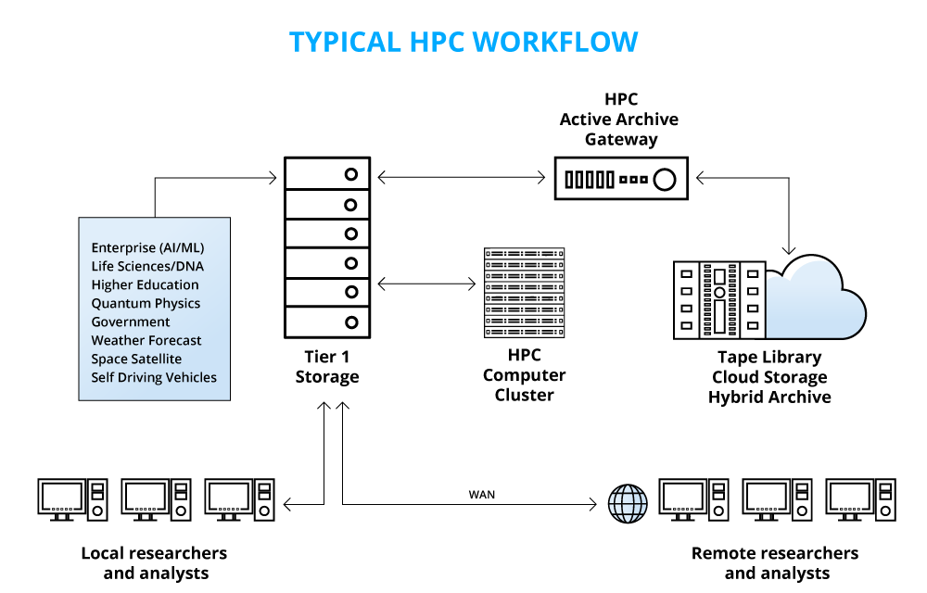
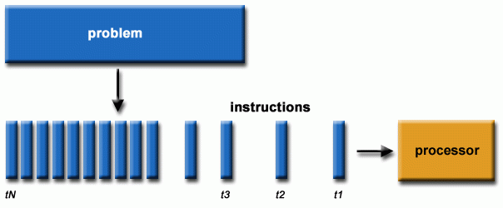
How Supercomputers Work
Parallel Architecture: Supercomputers utilize thousands of processors working together.
Complex Algorithms: Supercomputers use sophisticated algorithms to solve highly complex problems.

Slide 6


Applications of Supercomputers
Scientific Research: For simulations in physics, biology, and chemistry.
Weather Forecasting: Predicts weather patterns with high accuracy.
Medical Research: Used to simulate diseases and test drugs.
Space Exploration: Helps analyze data from space missions.

Slide 7



Famous Supercomputers
Fugaku (Japan): Currently the fastest supercomputer in the world.
Summit (USA): Used for research in AI, health, and climate change.
Sierra (USA): Designed for nuclear weapons simulations.

Slide 8
Challenges of Supercomputers
High Cost: Building and maintaining supercomputers is extremely expensive.
Energy Consumption: Supercomputers consume massive amounts of electricity.
Cooling Systems: They require advanced cooling technology to prevent overheating.

Slide 9
The Future of Supercomputers
Quantum Computing: Next-generation supercomputers could use quantum bits (qubits) to solve problems faster than ever before.
Increased Efficiency: New materials and design techniques may make supercomputers more energy-efficient and affordable.
AI and Machine Learning: Supercomputers will play a crucial role in advancing artificial intelligence and machine learning.

Slide 10

.

Slide 11

.
.

